Slide 1
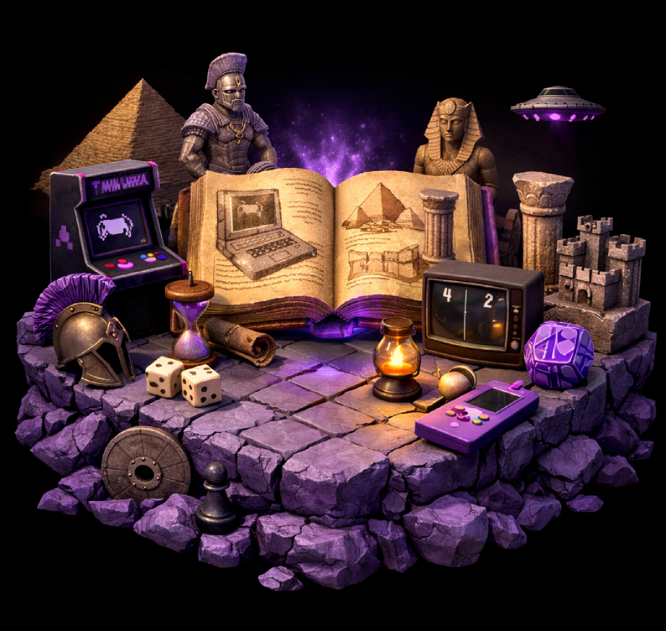
Game Programming, KFUPM
SWE 402, Lecture 2
A Brief History of Game Dev
Dr. Omar Hammad, KFUPM
Notes:
Welcome back, everyone. In today’s lecture, we’ll take a quick—but meaningful—tour through the history of game development. The goal isn’t to memorize dates; it’s to understand how games evolved and why certain design and technology shifts happened.

Slide 2
What is a game
Ancient game
Early videos games
Arcade games
Console games
Mobile
In today’s lecture
Notes:
By the end of this lecture, you should be able to: 1) Explain, at a high level, how games evolved from ancient board games to modern digital games. 2) Describe multiple definitions of ‘a game’ and extract common elements shared across them. 3) Recognize major milestones in video game history: early experiments, arcades, consoles, online multiplayer, and mobile. As we go, I’ll keep asking: what changed—technology, audience, business model, or design expectations?

Slide 3
What is a game?
Notes:
Before we talk history, let’s anchor on a basic question: What is a game? (Quick question to the class) If you had to define ‘game’ in one sentence, what would you say? There are many definitions, and each one emphasizes something different—rules, conflict, outcomes, or decision-making.

Slide 4
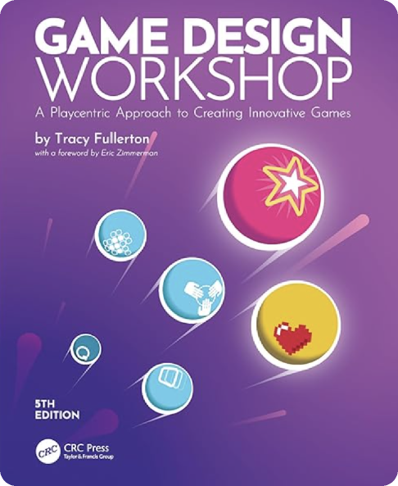
Multiple Definitions ..
“A closed formal system that engages players in structured conflict and resolves its uncertainty in an unequal out”
Game Design Workshop, Tracy Fullerton
Notes:
One strong definition comes from Tracy Fullerton (Game Design Workshop). She describes a game as a closed, formal system that engages players in structured conflict and resolves uncertainty with an unequal outcome. In other words: games create a world with boundaries (a system), they create tension (conflict), and they produce a result (someone wins, loses, or performs better).

Slide 5
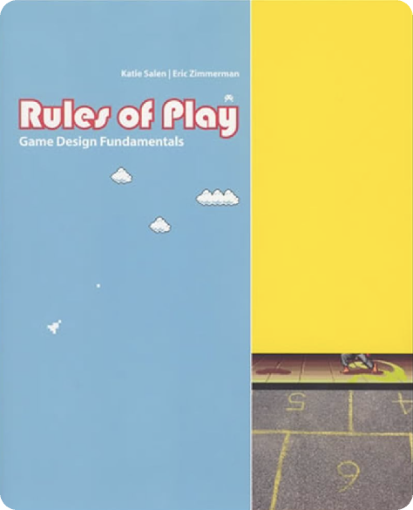
Multiple Definitions ..
“A system in which players engage in an artificial conflict, defined by rules that results in a quantifiable outcome”
Rules of Play, Katie Salen and Eric Zimmerman
Notes:
Another classic definition is from Katie Salen and Eric Zimmerman (Rules of Play). They define a game as a system where players engage in an artificial conflict, defined by rules, that results in a quantifiable outcome. Notice the emphasis here: ‘system’ + ‘rules’ + an outcome you can measure—score, time, ranking, win/loss.

Slide 6

Multiple Definitions ..
“A series of meaningful choices”
Sid Meier, Creator of Civilization
Notes:
A very famous—and very practical—definition comes from Sid Meier (Civilization): ‘A game is a series of meaningful choices.’ This is useful for us because it connects directly to design and programming. If the player’s choices don’t matter, the game becomes boring. If choices matter, then the game becomes strategic, emotional, and engaging.

Slide 7





Core Elements of a game ..
60:00
3 stock
Rules
Closed System
􀉩
􀉪
vs
Players
Winner!
Unequal Outcomes
Conflict
Notes:
If we compare these definitions, most games share a few core elements: - A closed system (the game world has boundaries) - Rules (what is allowed / not allowed) - Players (one or more participants interacting with the system) - Structured conflict (challenge, competition, scarcity, risk) - Unequal outcomes (somebody ‘does better’ or wins) Even when a game is cooperative, there is still conflict—often against the environment or the system.

Slide 8
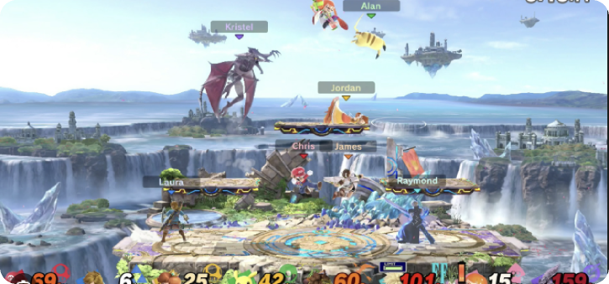

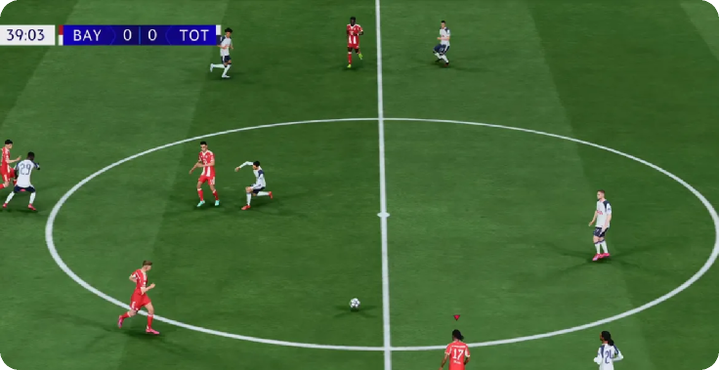
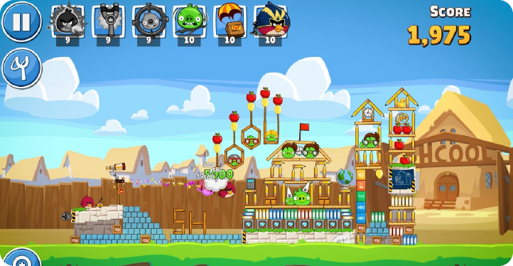
Apply game elements to known games ..
Notes:
Let’s apply this quickly. Think about Super Smash Bros, Among Us, or any game you play often. (Ask students) Where do you see: rules, conflict, and a measurable outcome? This is a good habit: whenever you study a new game genre, break it down into these elements before you talk about graphics or code.

Slide 9
First game in history?
Notes:
Now, let’s go back in time. Question: What was the first game in history? (Ask students) Give me a guess. Are we talking about board games? sports? gambling games? The key idea: games existed long before electronics—humans have always used play to compete, learn, and socialize.

Slide 10
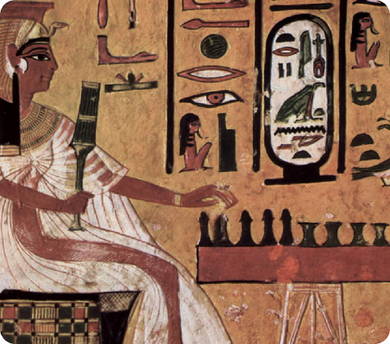
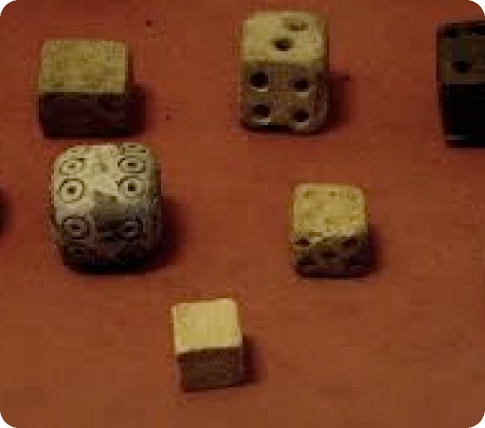
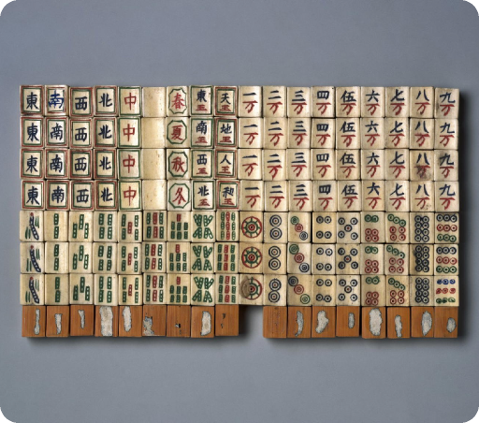
Thousands of years ago..
Board Games
Rolling a dice
Tiles and Dominos
Egypt 3500 B.C
Persia 3000 years ago
2900 years ago
Notes:
To avoid philosophical debates, here are examples of very early games and game components: - Ancient board games in Egypt, including Senet (evidence from around the 3rd millennium BCE). - Dice and other randomizers show up across ancient civilizations; the exact ‘first’ is debated, but they are extremely old. - Tile-based games that later evolved into domino-like systems also appear early in history. The point is not the exact first instance—it’s that core game ideas (rules + chance + strategy) are ancient.

Slide 11
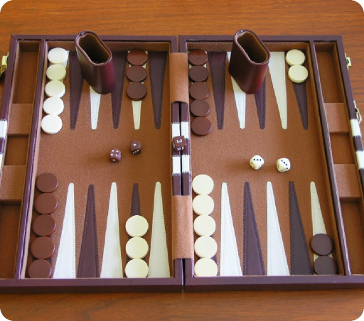
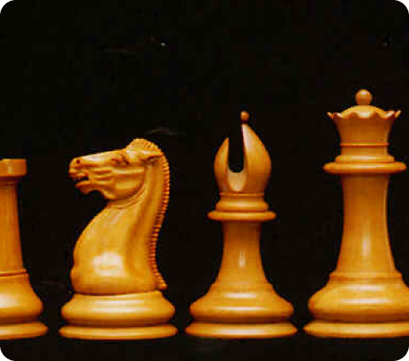
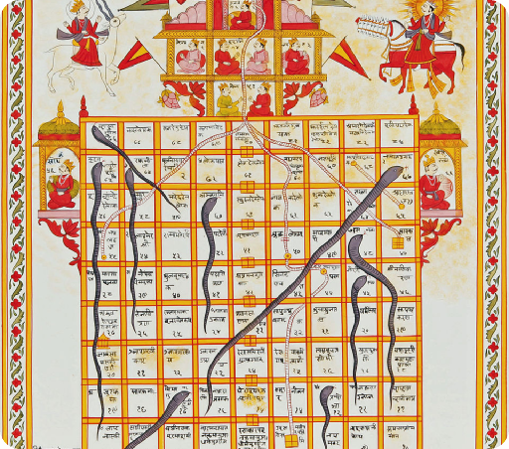
600 A.D to 17th century ..
Backgammon
Chess
Snakes & Ladder
600 A.D
600 A.D
16th Century
Other games including: Downfall, Hungry Hippos, and Connect in 1800s
Notes:
Fast-forward to more recognizable classics: - Backgammon has very old roots (played in forms for many centuries). - Chess becomes widely established by around the early medieval period. - Snakes and Ladders appears in earlier forms and becomes popular much later. - By the 1800s, we see many mass-produced physical games. Notice: as manufacturing improved, games became easier to distribute—this matters later when we talk about arcades and consoles.

Slide 12
What about video games?
Notes:
All of that is non-electronic. But this course focuses mainly on video games—games that run on electronic systems. So the next question is: What were the first electronic or video games?

Slide 13
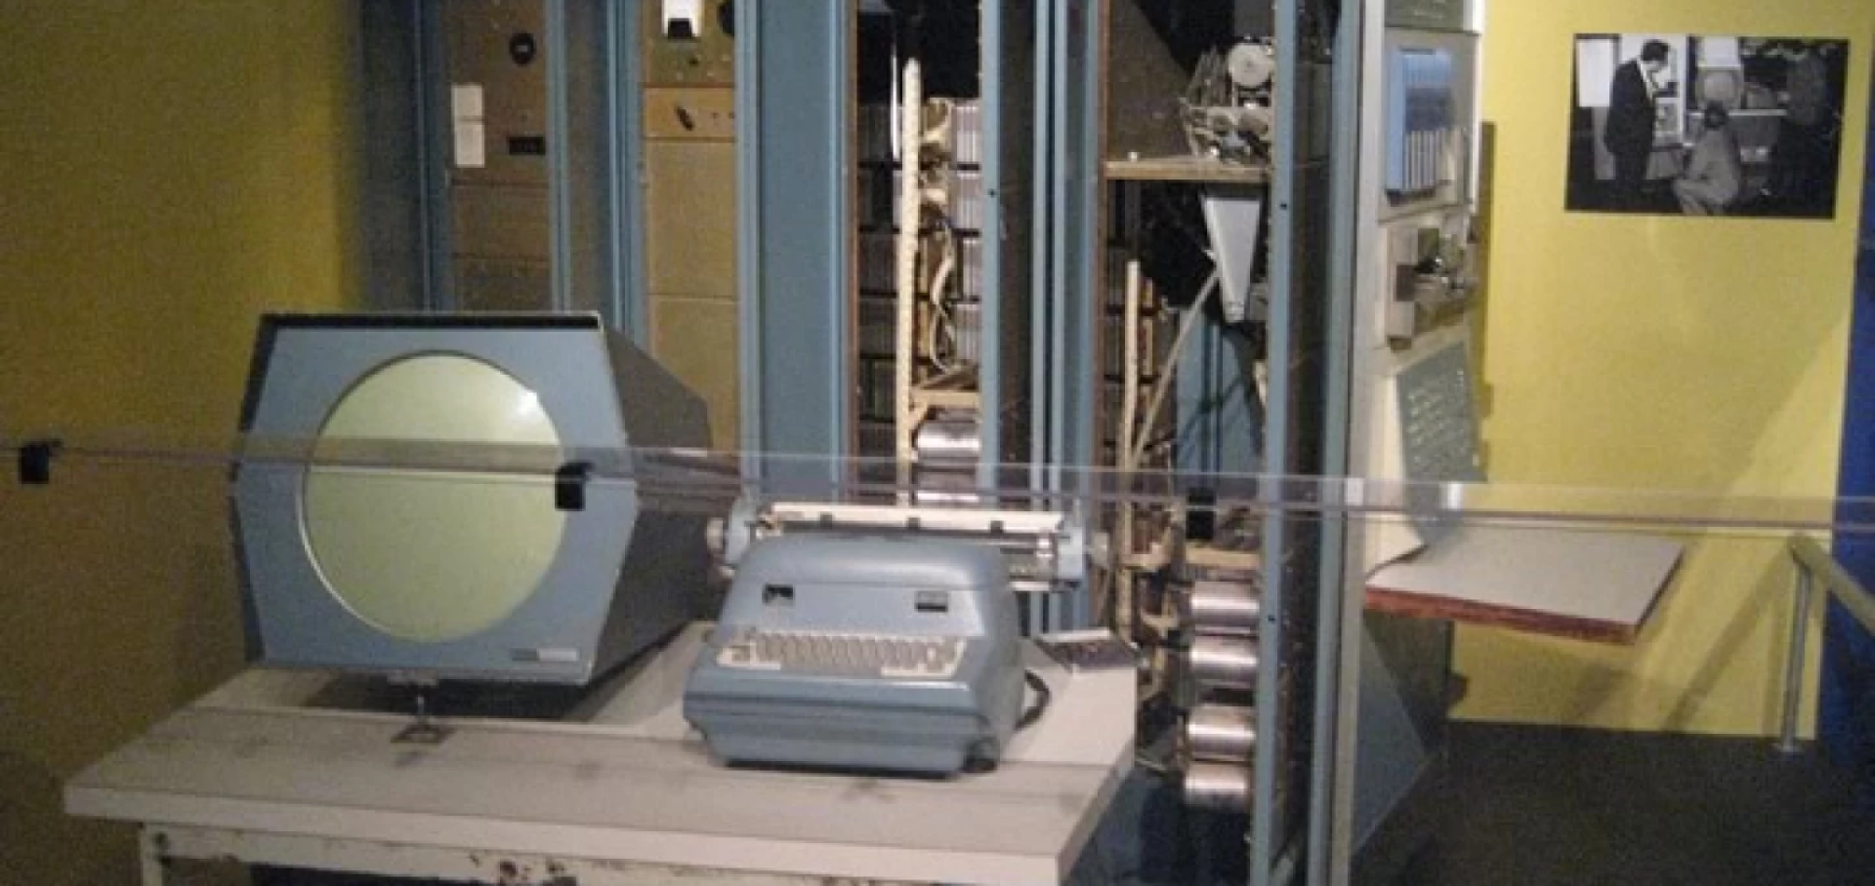
Cathode-ray amusement device in 1947
Notes:
One of the earliest known interactive electronic game concepts is the cathode-ray tube amusement device. It was patented based on work filed in 1947 (patent issued in 1948). It wasn’t a modern computer game, but it’s important historically because it shows early interactive entertainment on an electronic display.

Slide 14

Tennis for two in 1958
Notes:
Another early milestone is Tennis for Two (1958), built by William Higinbotham. It used an oscilloscope display and an analog computer to simulate a tennis-like trajectory. This is a great example of how research labs accidentally became the birthplace of interactive games.

Slide 15
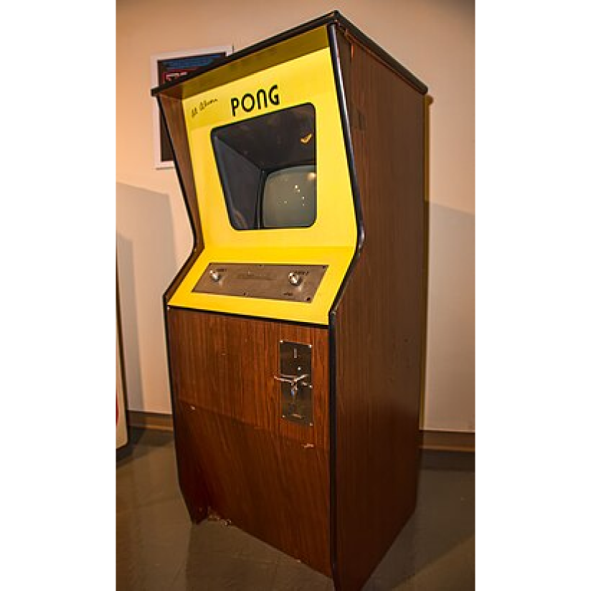
Pong 1972
Notes:
For a while, computer games existed in limited environments—labs and universities. But the major shift happened when games became commercial and public. That’s why Pong (1972) matters: it became the first commercially successful arcade video game and helped establish the industry.

Slide 16
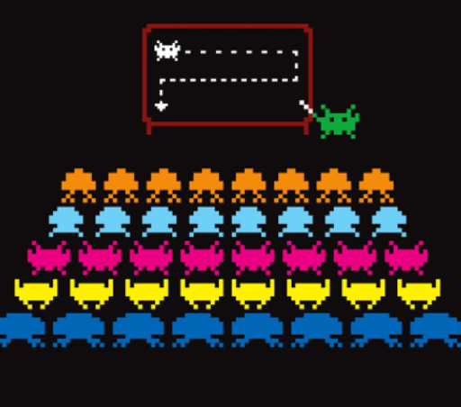
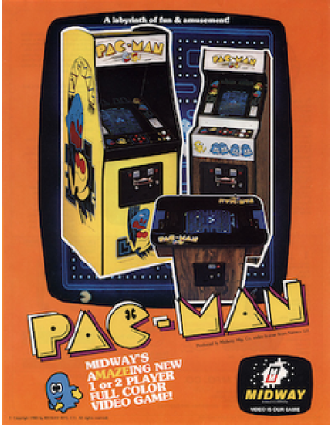
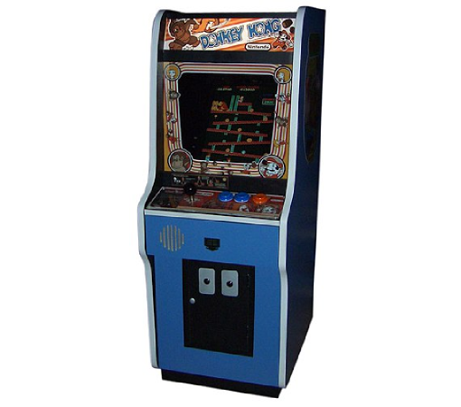
Many successful Arcade games in the 70s-early 80s
Space Invaders
Pac-man
Donkey kong
Taito, 1978
Namco, 1980
Nintendo, 1981
Notes:
After Pong, arcades exploded in the late 1970s and early 1980s. We get iconic games that shaped player expectations: - Space Invaders (1978) - Pac-Man (1980) - Donkey Kong (1981) These games established core loops, difficulty curves, high scores, and recognizable characters—basically, the DNA of arcade design.

Slide 17
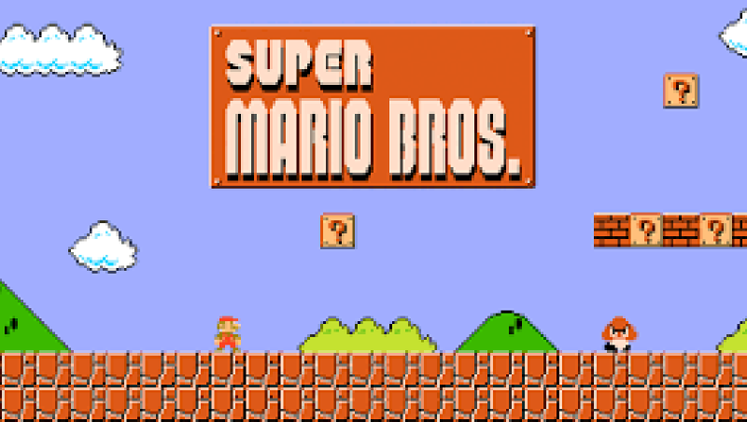
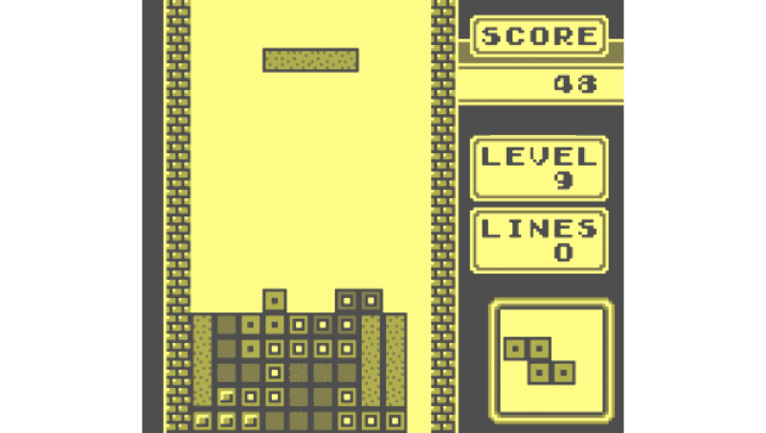
Mid-late 80s
NES with Super Mario
Gameboy with Tetris
Notes:
In the mid-1980s, gaming shifts from public arcades to the home. Nintendo plays a key role with the NES (mid-80s in North America) and then portable gaming with the Game Boy (late 80s), famously bundled with Tetris in key markets. This period proves that games can be a long-term home hobby, not just a coin-operated activity.

Slide 18
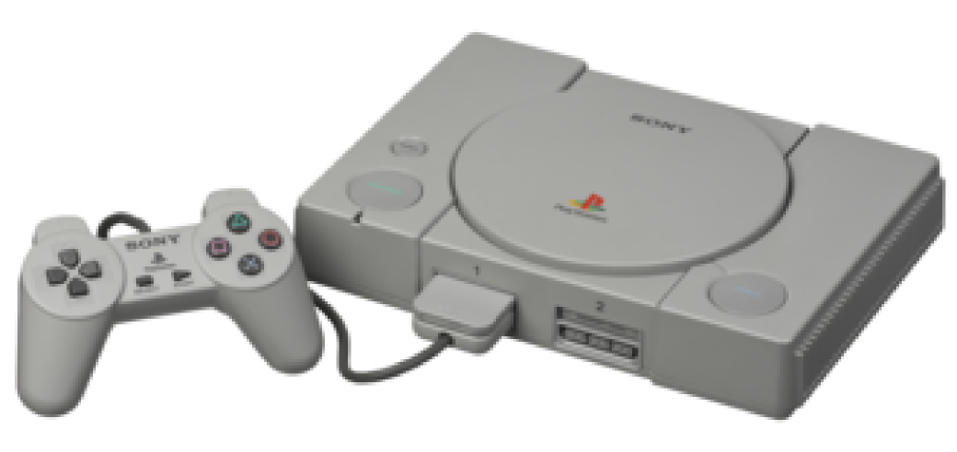
Playstation, 1994
Notes:
In 1994, Sony releases the original PlayStation in Japan. One big shift was distribution: CDs made it easier to ship larger games with more audio/video content than cartridges typically allowed at the time.

Slide 19
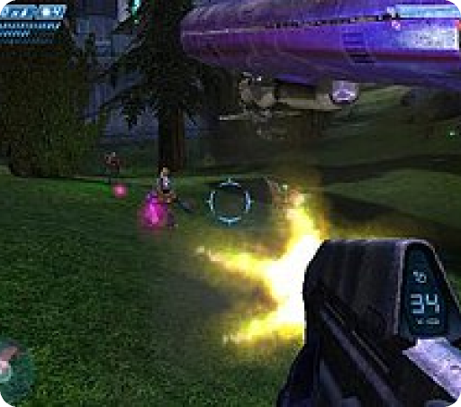
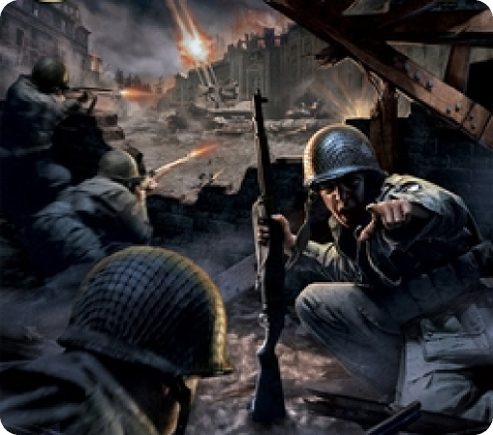
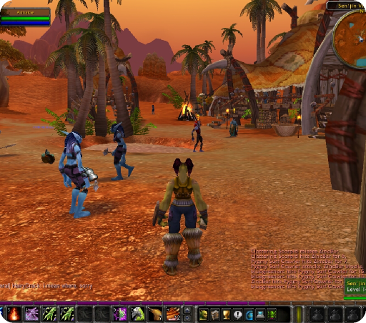
Multiplayer boomed early 2000s
Halo
Call of duty
World of Warcraft
Xbox 2001
PC, 2003
PC, 2004
Notes:
In the early 2000s, online multiplayer becomes mainstream on consoles. Xbox Live launched in 2002, and games like Halo (released in 2001) became major system sellers. On PC, we also see huge growth in online and competitive play. Call of Duty (2003) becomes a major franchise starter. And World of Warcraft launches in 2004 and becomes a defining example of large-scale online worlds—reaching 12 million subscribers at its peak.

Slide 20
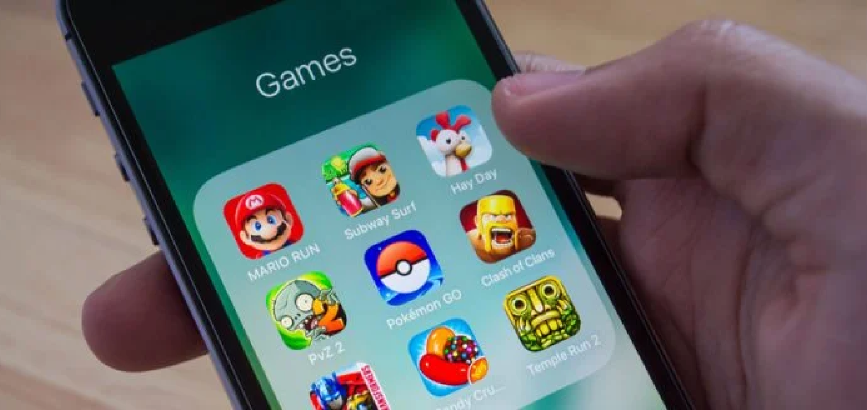
iPhone 2007
Notes:
In 2007, the iPhone changes the market again. Smartphones create a new platform with: - touch controls - very short play sessions - app stores for instant distribution This pushes new business models and new design constraints. Early popular mobile titles include Angry Birds, Fruit Ninja, Cut the Rope, and Doodle Jump (we’ll discuss what made these work in a later lecture).

Slide 21
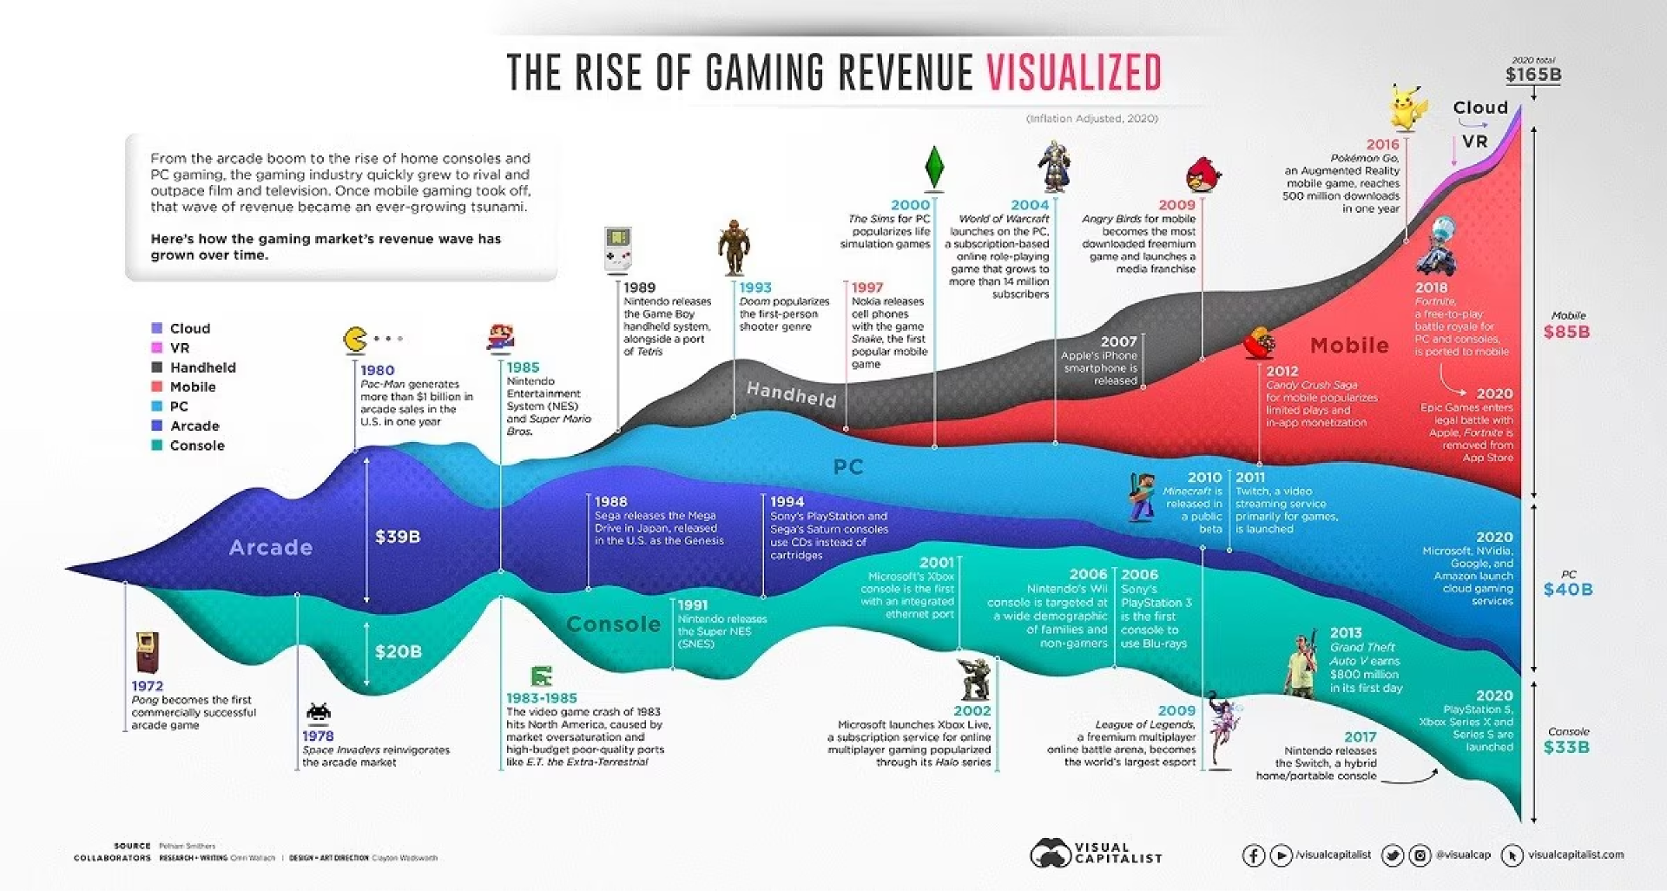
Notes:
So this was a fast timeline. The key takeaway is that game development evolves when one of these changes: - hardware capability - distribution (arcade → console → online → app store) - player audience and habits - business models In a later lecture, we’ll focus on today’s industry—where it’s heading, what’s growing, and what skills matter most for modern game developers.

Slide 22

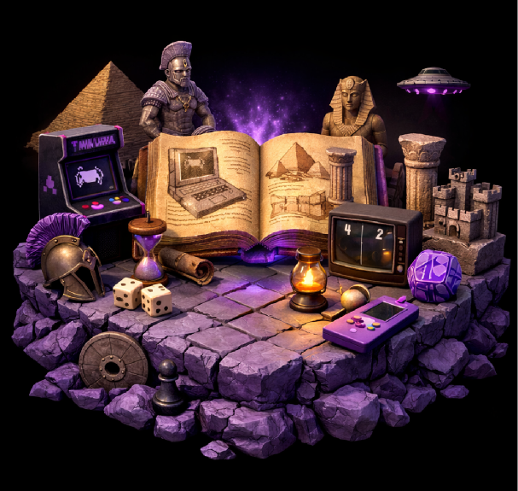
Game Programming, KFUPM
By Dr. Omar Hammad
join the discussion
discord.gg/jSyF3RJS
Thank you
Notes:
Closing question (to check understanding): If you had to pick ONE milestone that changed game development the most—what would it be, and why? Is it: - arcades (public access) - consoles (home gaming) - online multiplayer (social + scale) - mobile (distribution + new audience) Post your answer in the discussion channel.

